Slide 1
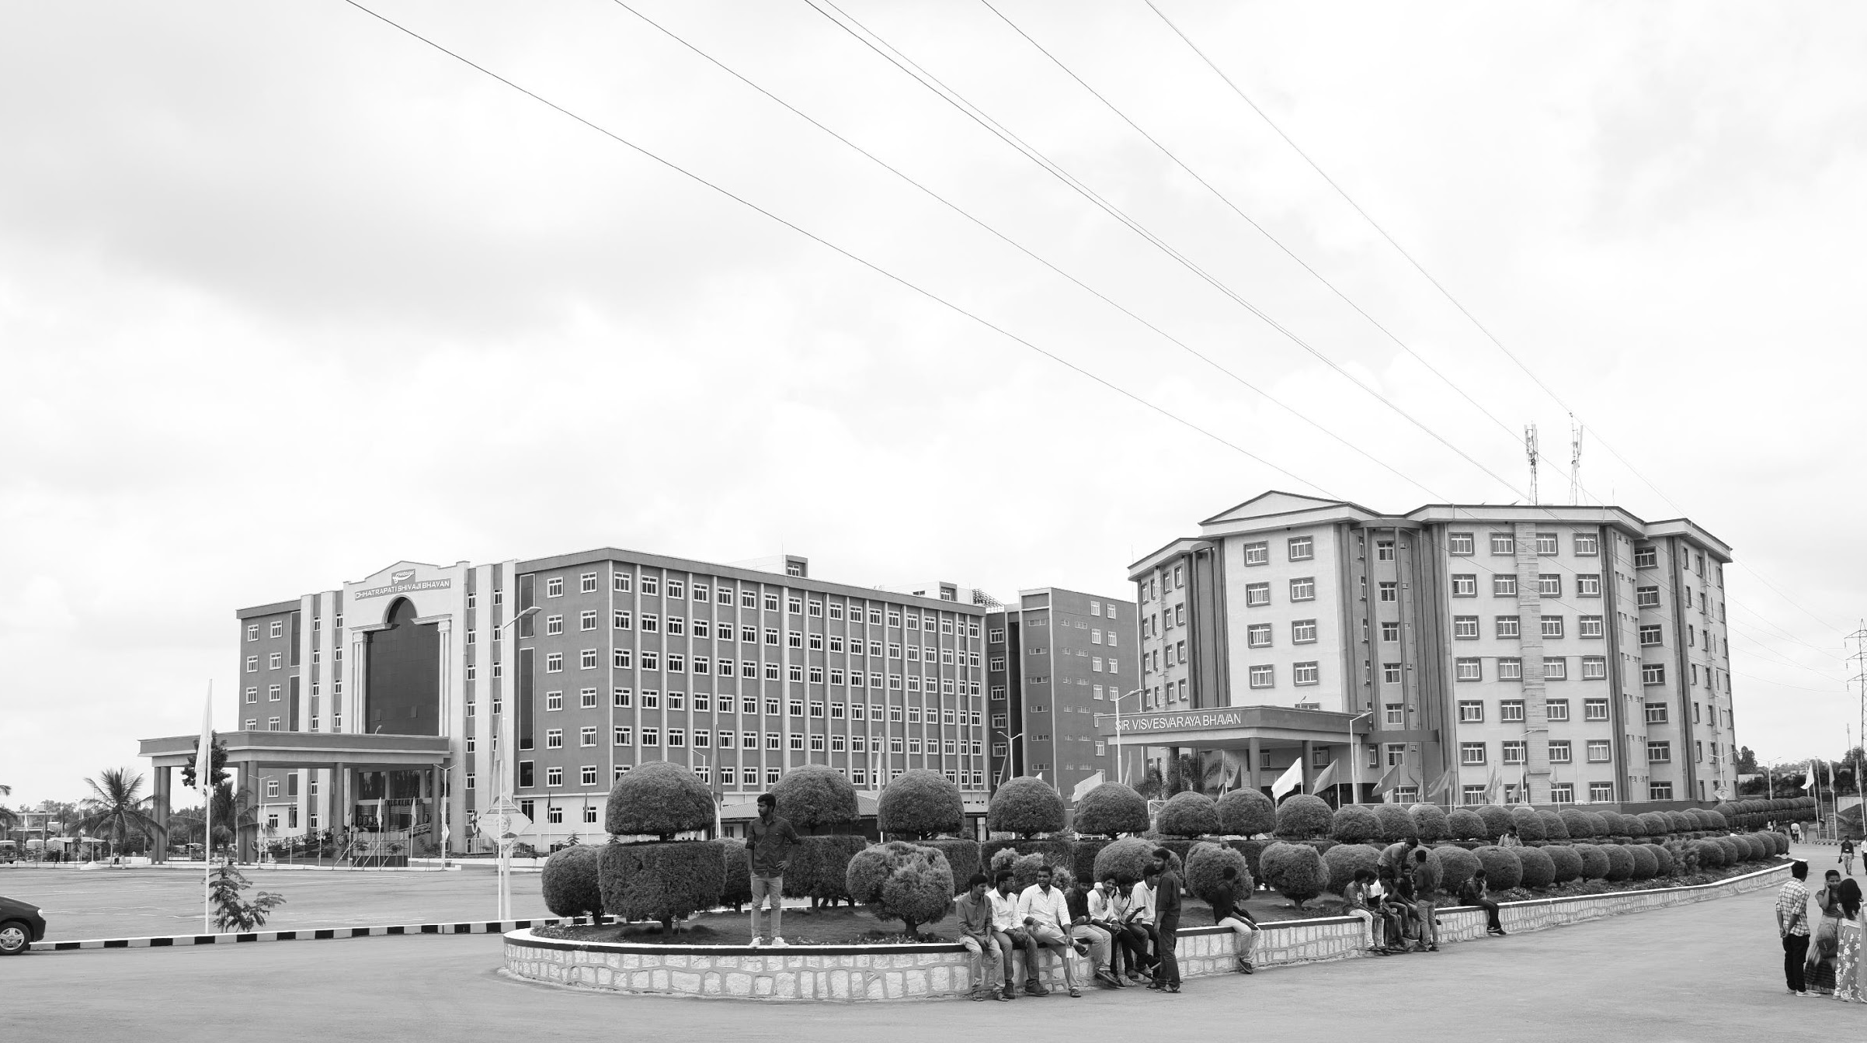

HEALTH MONITORING SYSTEM FOR AUTOMOBILES(ENGINE PARAMETERS)
AY 2020-24
GITAM UNIVERSITY
Major Project
Project ID: V17
A University should be a place of light, of liberty, and of learning.
Department of Electrical Electronics and Communication Engineering
Project Team:
K. SOWMYA
R. MOKSHITHA
M. LOK VIGNESH
Project Mentor:
www.gitamedu.com

Slide 2




Project Group – Details
Photo
Track
Roll No
Name
EECE AI/ML
BU21EECE0100099
M. LOK VIGNESH
EECE AI/ML
BU21EECE0100160
R. MOKSHITHA
EECE AI/ML
BU21EECE0100475
K. SOWMYA

Slide 3
Objective and Goals
Objective
Condition Of Engine(parameters- Engine RPM, Lub. Oil pressure, Fuel pressure, Coolant pressure, Lub. Oil temperature, Coolant pressure) or EV.
Improve Vehicle Reliability and Safety
Optimize Vehicle/Engine Performance and Efficiency
Reduce Maintenance Costs
Enhance Customer Satisfaction
Goals
Main Goals
Reduce breakdowns, increase uptime, enhance driver safety, and minimize accident risks.
Improve fuel efficiency, enhance engine performance, and reduce emissions.
Enable predictive maintenance, optimize maintenance schedules, and reduce overall costs.
Provide peace of mind, improve customer loyalty, and offer personalized maintenance recommendations.
Additional Goals
Provide features that allow owners to remotely monitor and control their vehicles
Incorporate technologies like autonomous emergency braking, lane departure warning, and blind spot monitoring.
Use eco-friendly materials in vehicle construction.
Offer personalized maintenance plans and services based on individual driving habits and preferences.

Slide 4
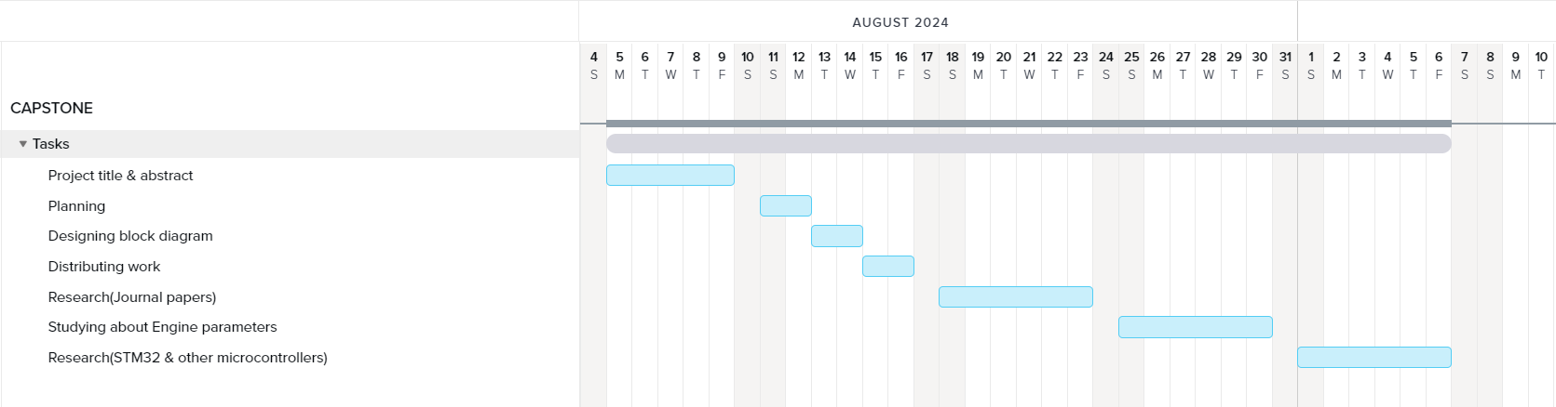
Project Plan
Gant Chart - Milestones and Activities

Slide 5
Literature Survey
Key Publications
Nithish Kanna J L Krishnakumar G, Muhammad Aadhil M, Dr. Ajay V P “Predictive Maintenance of Motors using Machine Learning”, Kumaraguru College of Technology.
H.E.G. Po~e and C.E. Fisher “Engine Health Monitoring: Towards Total Prognostics ”, United Kingdom.
Ryan Ahmed, Mohammed El Sayed, S. Andrew Gadsden, Jimi Tjong, and Saeid Habibi “Automotive Internal-Combustion-Engine Fault Detection and Classification Using Artificial Neural Network Techniques”, 2015.
Key Resources – Whitepaper| Application Notes | Datasheet| Others
Predictive Maintenance for Automotive
The Future of Automotive Health Monitoring
Application Note: Implementing a Real-Time Health Monitoring System for Electric Vehicles
IoT Gateway for Vehicle Health Data Collection
Existing Implementations – Products| Opensource| GitHub etc
Bosch Automotive
Continental
Vehicle Health Monitoring Platform (VHMP)
Predictive Maintenance for Automotive Engines
IoT-based Vehicle Health Monitoring

Slide 6
Analysis - SWOT
Strengths
Weaknesses
Advanced sensor technology: The availability of accurate and reliable sensors for measuring engine parameters.
Data analytics capabilities: The ability to process and analyze large amounts of data to identify patterns and anomalies.
Predictive maintenance potential: The potential to prevent breakdowns and reduce maintenance costs through early detection of issues.
Improved safety: The ability to identify and address potential safety hazards related to engine malfunctions.
Enhanced customer satisfaction: The potential to improve customer satisfaction by providing peace of mind and reducing vehicle downtime.
Data privacy concerns: The collection and storage of sensitive vehicle data raises privacy concerns.
Complexity of integration: Integrating a health monitoring system with existing vehicle electronics can be complex.
Dependency on technology: The system's effectiveness relies on the reliability and accuracy of sensors and data analytics algorithms.
Potential for false positives or negatives: The system may generate false alarms or fail to detect certain issues.
Opportunities
Threats
Growing demand for connected vehicles: The increasing popularity of connected vehicles presents opportunities for integrating health monitoring systems with other vehicle features.
Advancements in machine learning: Improvements in machine learning algorithms can enhance the accuracy and reliability of predictive maintenance models.
New business models: The development of new business models based on health monitoring data, such as usage-based insurance or predictive maintenance services.
Regulatory requirements: The increasing emphasis on vehicle safety and emissions regulations may drive the adoption of health monitoring systems.
Competitive pressures: The emergence of competing technologies or business models may erode the market position of health monitoring systems.
Economic downturns: Economic downturns may reduce consumer demand for advanced vehicle features, including health monitoring systems.
Regulatory changes: Changes in regulations or standards may impact the design and implementation of health monitoring systems.

Slide 7
Analysis – 4W1H
Why:
Early detection of engine issues can prevent costly repairs and breakdowns.
Monitoring critical parameters can identify potential safety hazards, such as overheating or oil pressure loss.
Optimizing engine performance through real-time data can lead to better fuel economy.
What:
A system that continuously monitors and records key engine parameters: Engine RPM, Lubricating Oil Pressure, Fuel Pressure, Coolant Pressure, Lubricating Oil Temperature, and Coolant Temperature.
A user interface (dashboard or app) to display real-time data and generate alerts for abnormal conditions.
Integration with existing vehicle systems (e.g., OBD-II) for data collection and communication.
Where: This system can be installed in a variety of vehicles, including passenger cars, trucks, and commercial vehicles.
When: The system should operate continuously while the vehicle is in use. Data can be stored and analyzed for trend analysis and predictive maintenance.
How:
Refined Objective: To develop a robust and cost-effective health monitoring system for automobiles that accurately measures critical engine parameters, provides real-time data visualization, and generates timely alerts to prevent breakdowns, enhance safety, and optimize vehicle performance.
Utilize sensors to measure engine parameters.
Implement data acquisition and processing units to collect and analyze data.
Develop a user interface to display real-time data and generate alerts.
Consider cloud-based solutions for data storage and remote monitoring

Slide 8
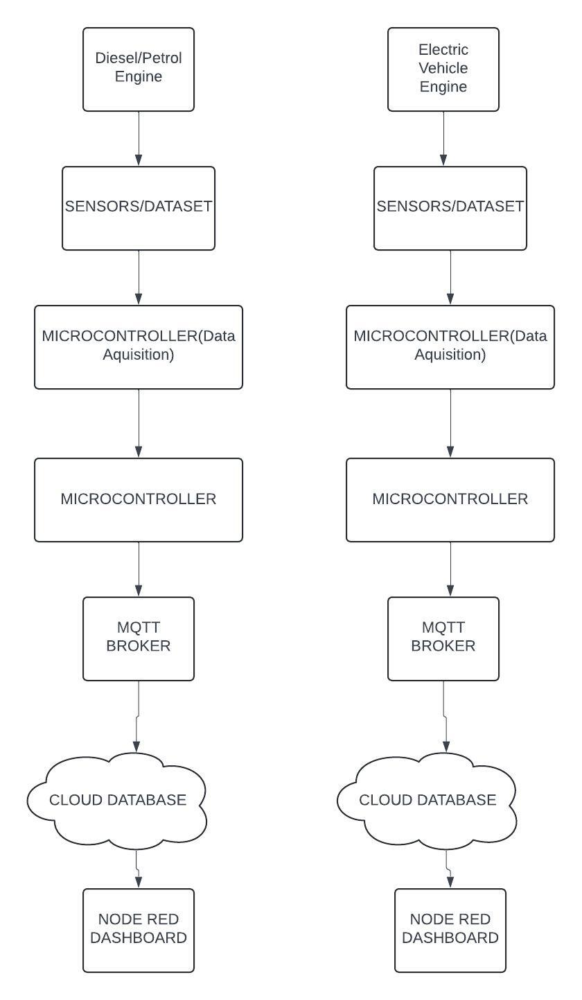
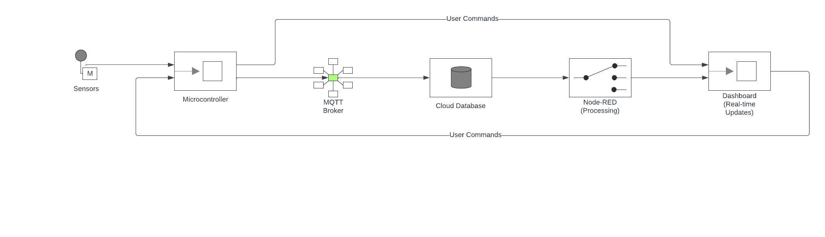
Architecture
Behaviour Diagram
Structural Diagram

Slide 9
Use Cases & Testing
Use Cases
Engine Health Monitoring
Predictive Maintenance
Real-Time Fault Alerts
User Command Interaction
Test Cases
Sensor Data Collection
MQTT Data Transmission
Cloud Database Storage
Node-RED Data Processing
Dashboard Real-Time Update

Slide 10

Implementation and Results – Iteration 1
#include <WiFi.h>
#include <PubSubClient.h>
#include <DHTesp.h>
const int DHT_PIN = 15;
DHTesp dht;
const char* ssid = "Wokwi-GUEST";
const char* password = "";
const char* mqtt_server = "test.mosquitto.org";
WiFiClient espClient;
PubSubClient client(espClient);
unsigned long lastMsg = 0;
float temp = 0;
float hum = 0;
void setup_wifi() {
delay(10);
Serial.println();
Serial.print("Connecting to ");
Serial.println(ssid);

Slide 11
Implementation and Results - CODE
WiFi.mode(WIFI_STA);
WiFi.begin(ssid, password);
while (WiFi.status() != WL_CONNECTED) {
delay(500);
Serial.print(".");
}
randomSeed(micros());
Serial.println("");
Serial.println("WiFi connected");
Serial.println("IP address: ");
Serial.println(WiFi.localIP());
}
void callback(char* topic, byte* payload, unsigned int length) {
Serial.print("Message arrived [");
Serial.print(topic);
Serial.print("] ");
for (int i = 0; i < length; i++) {
Serial.print((char)payload[i]);
}}

Slide 12
Implementation and Results - CODE
void reconnect() {
while (!client.connected()) {
Serial.print("Attempting MQTT connection...");
String clientId = "ESP32Client-";
clientId += String(random(0xffff), HEX);
if (client.connect(clientId.c_str())) {
Serial.println("Connected");
client.publish("/ThinkIOT/Publish", "Welcome");
client.subscribe("/ThinkIOT/Subscribe");
} else {
Serial.print("failed, rc=");
Serial.print(client.state());
Serial.println(" try again in 5 seconds");
delay(5000);
}}
}
void setup() {
pinMode(2, OUTPUT);
Serial.begin(115200);
setup_wifi();
client.setServer(mqtt_server, 1883);
client.setCallback(callback);
dht.setup(DHT_PIN, DHTesp::DHT22);
}

Slide 13
Implementation and Results - CODE
void loop() {
if (!client.connected()) {
reconnect();
}
client.loop();
unsigned long now = millis();
if (now - lastMsg > 2000) { //perintah publish data
lastMsg = now;
TempAndHumidity data = dht.getTempAndHumidity();
String temp = String(data.temperature, 2);
client.publish("/Thinkitive/temp", temp.c_str());
String hum = String(data.humidity, 1);
client.publish("/Thinkitive/hum", hum.c_str());
Serial.print("Temperature: ");
Serial.println(temp);
Serial.print("Humidity: ");
Serial.println(hum);
}
}

Slide 14
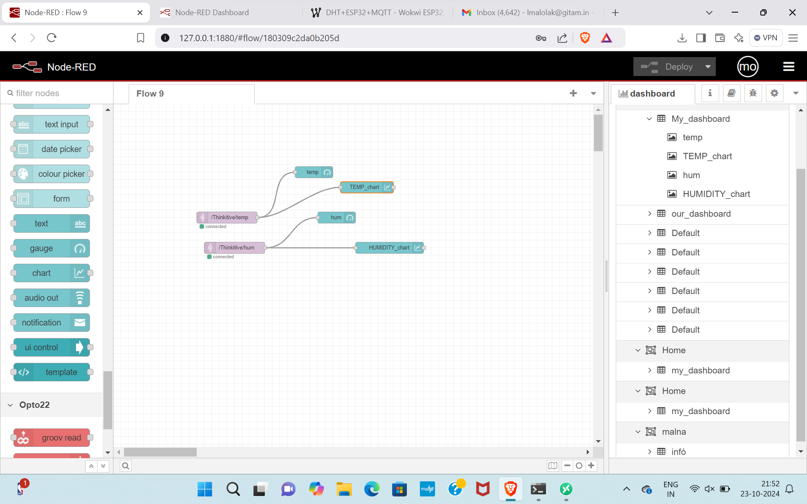
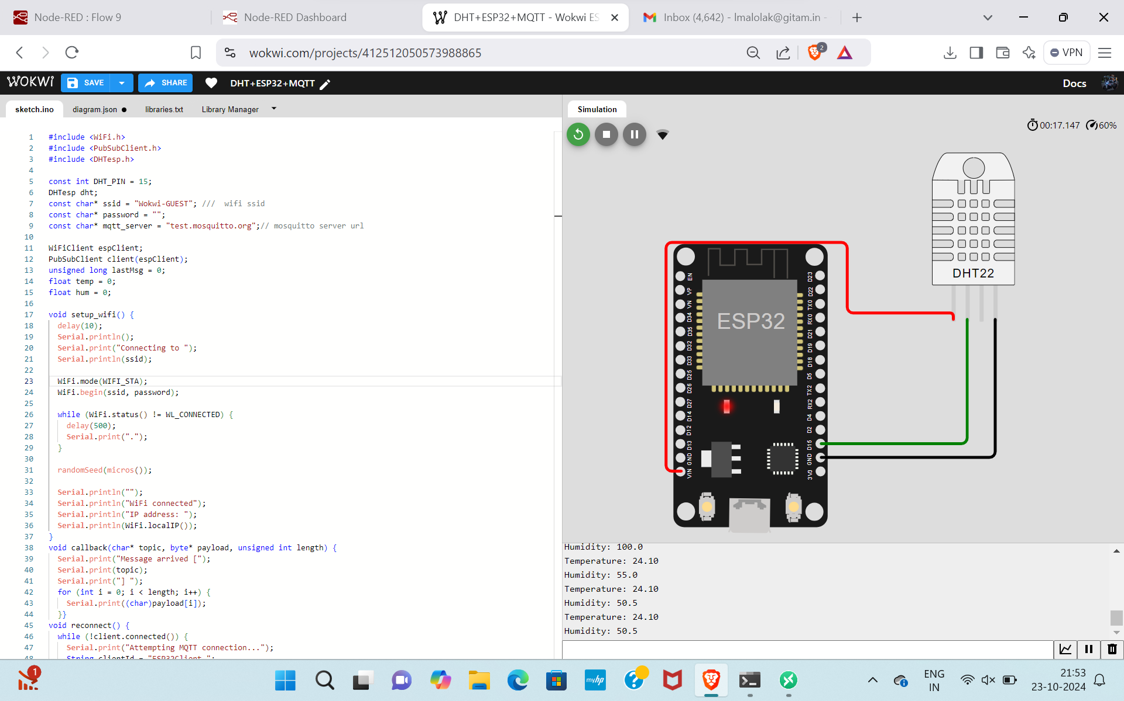
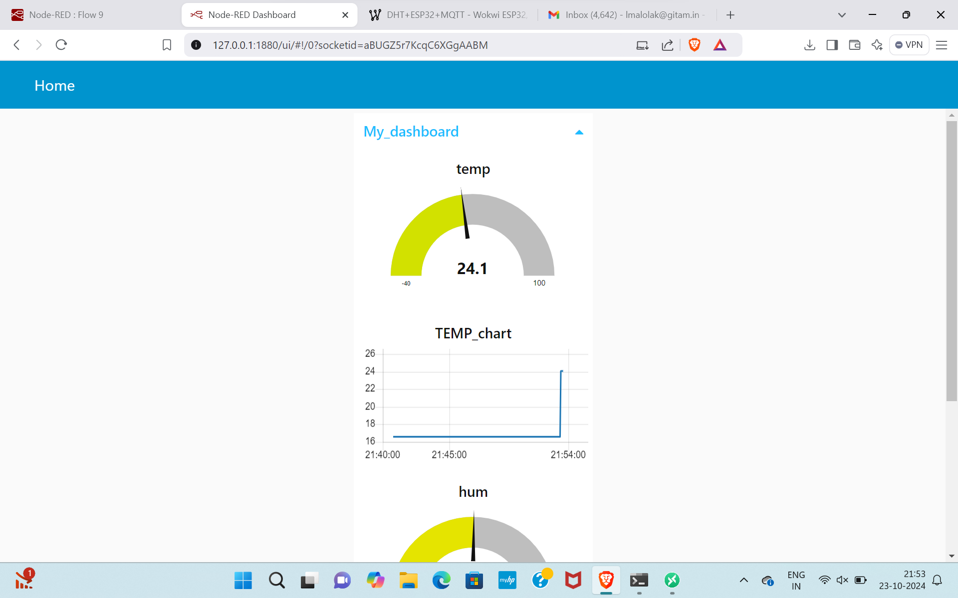
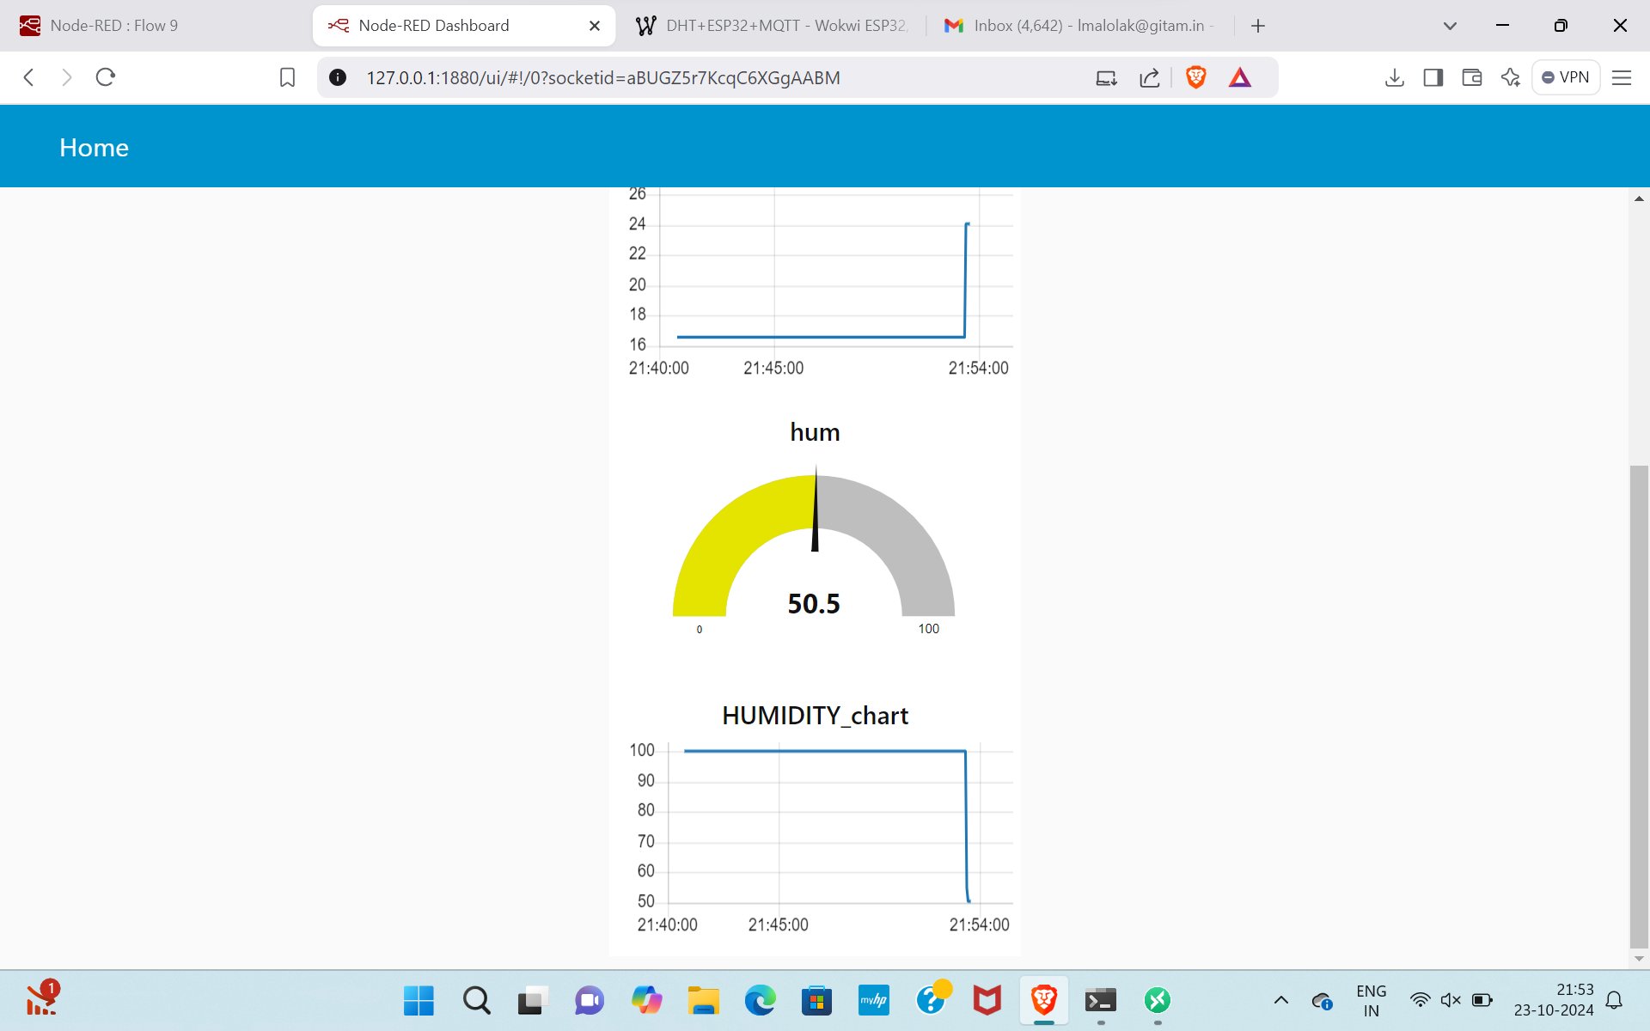
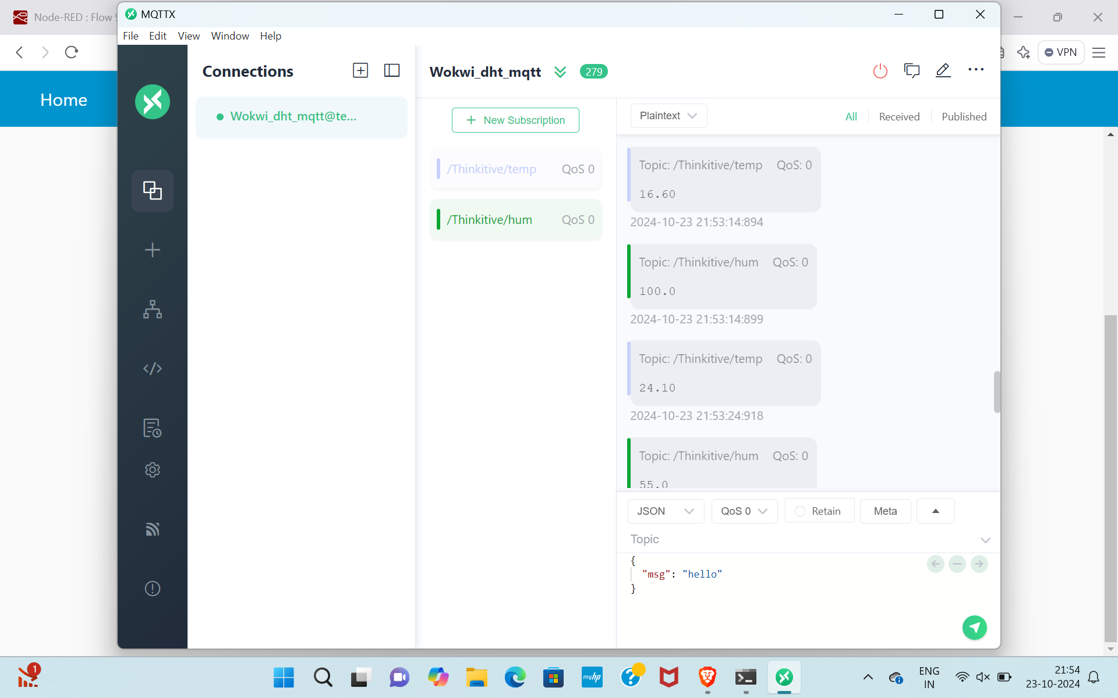
Implementation and Results – Iteration 1
Iteration 1 : Results

Slide 15
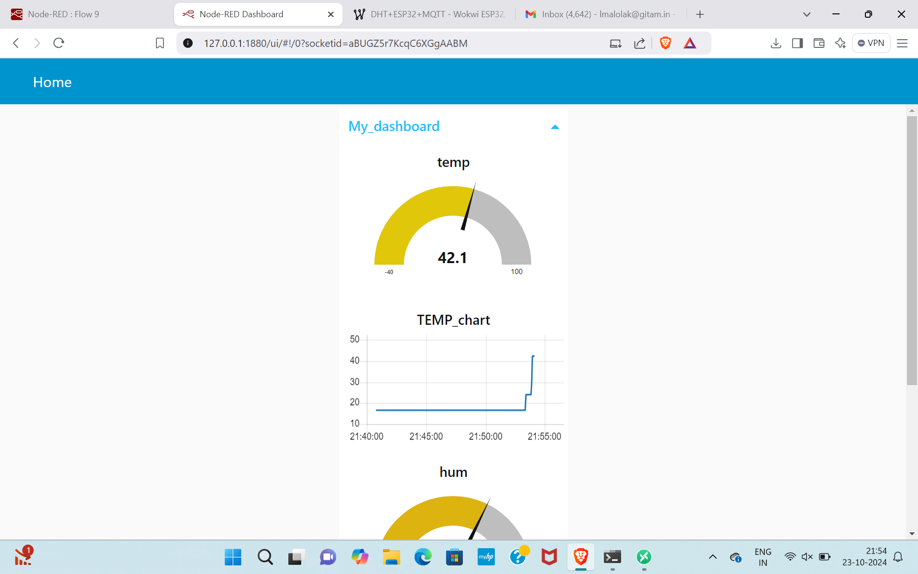
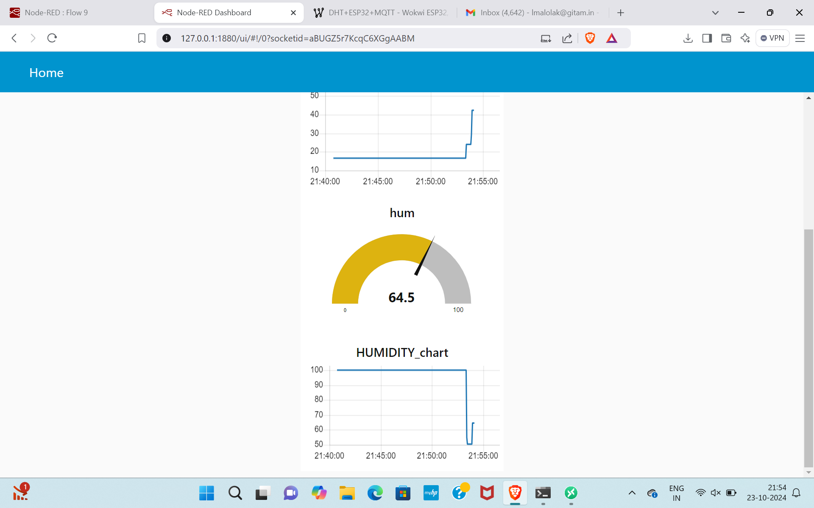

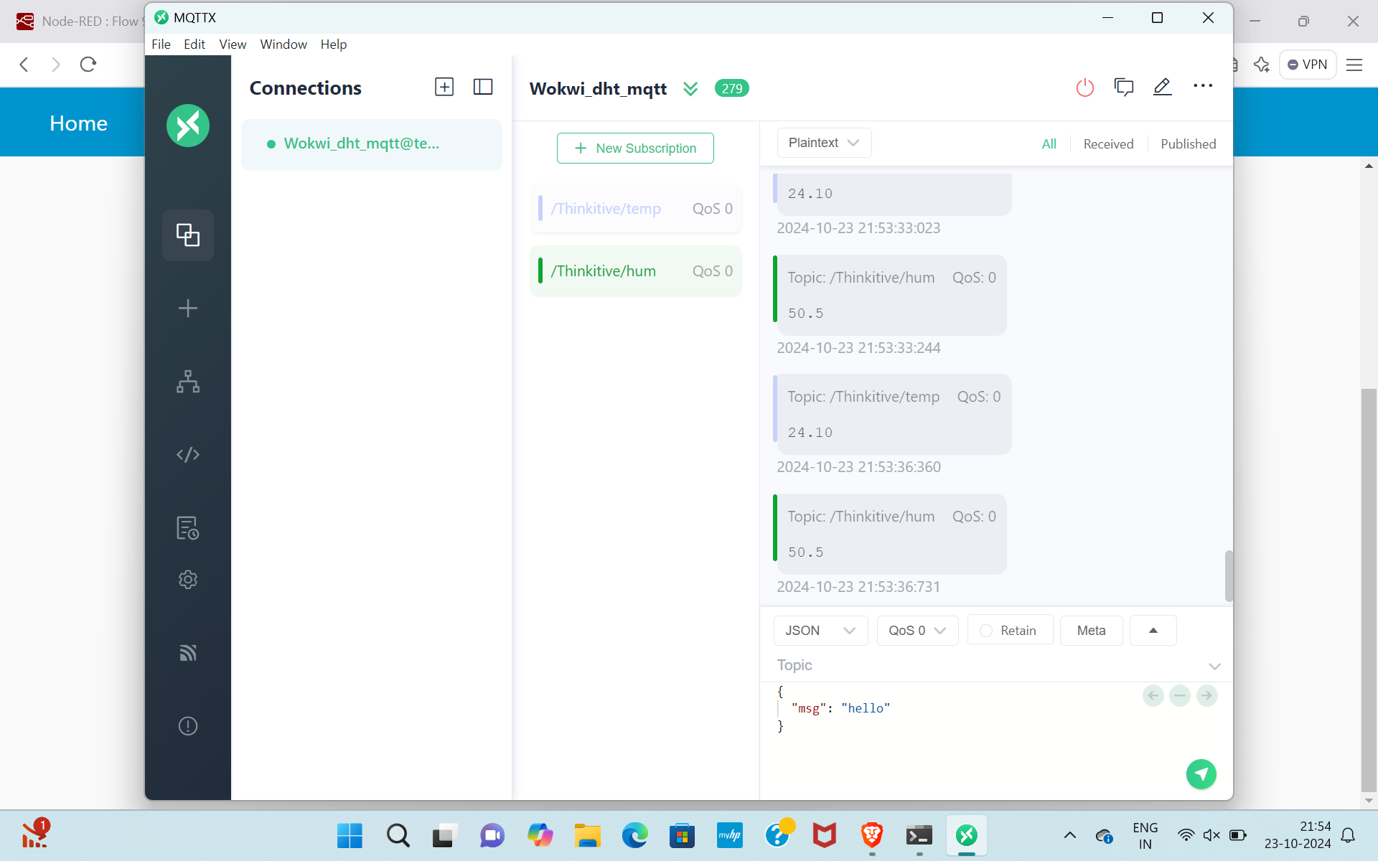
Implementation and Results – Iteration 2
Iteration : Results + Validation against the usecases and test cases

Slide 16

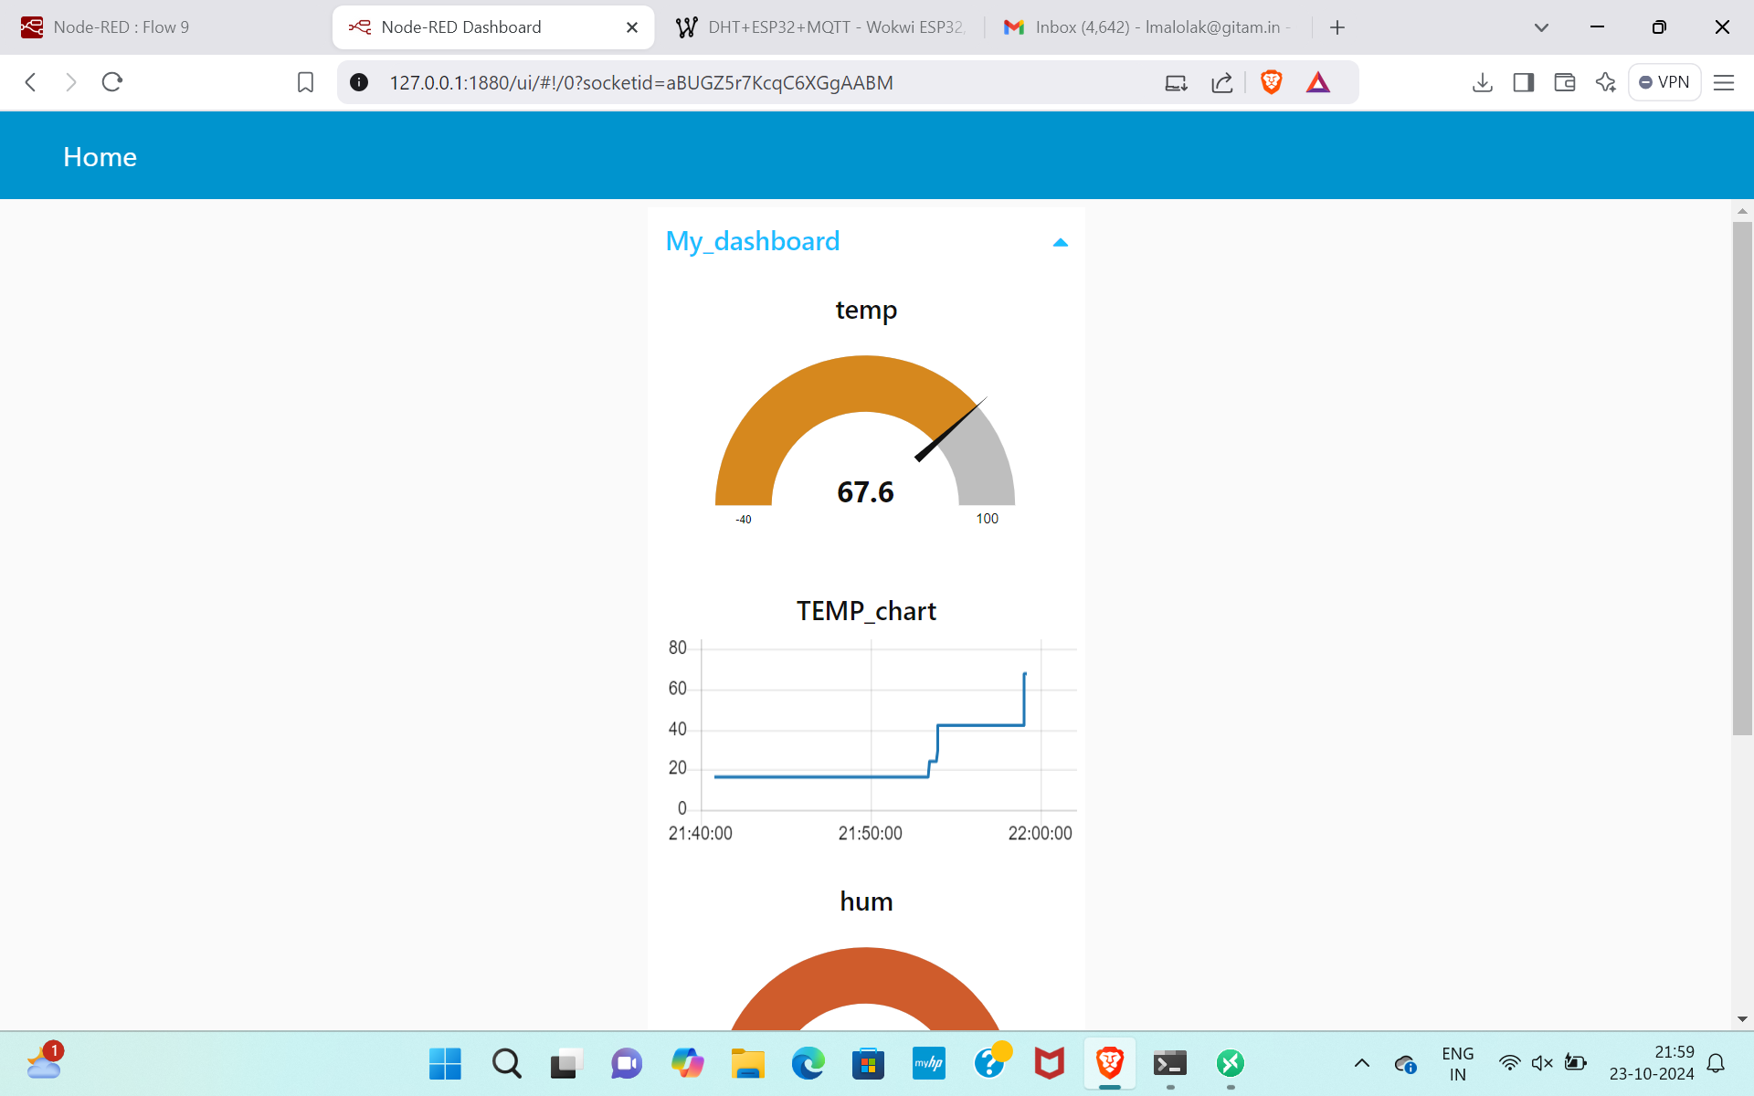
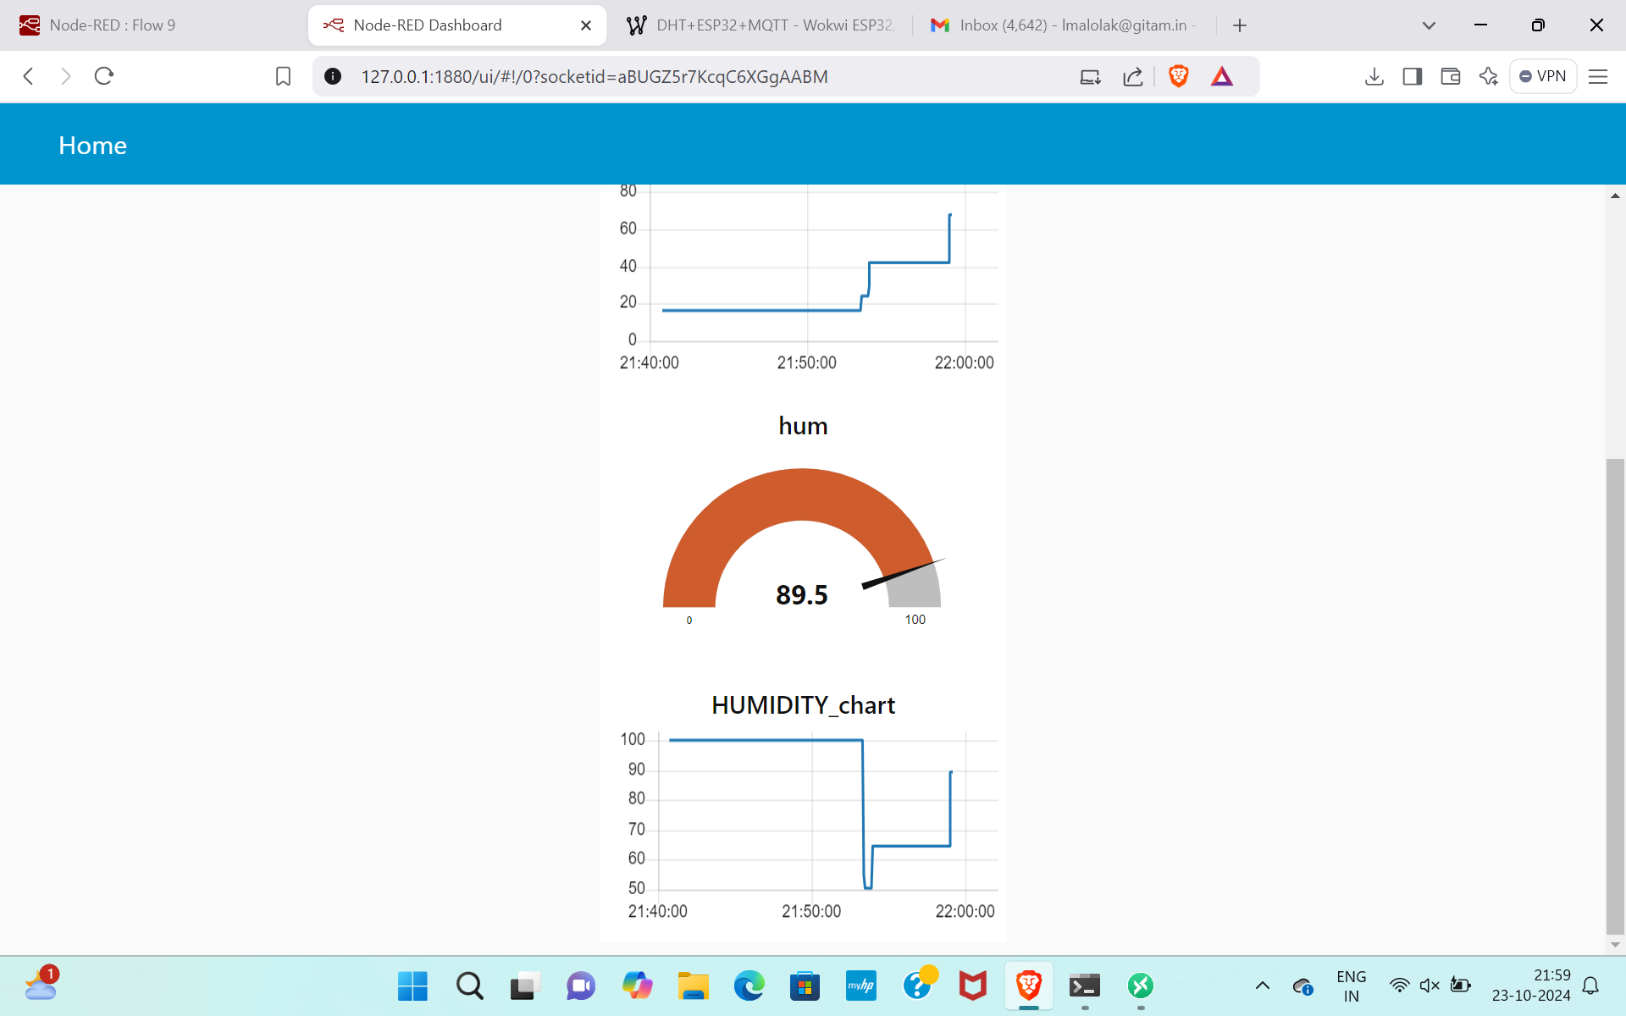
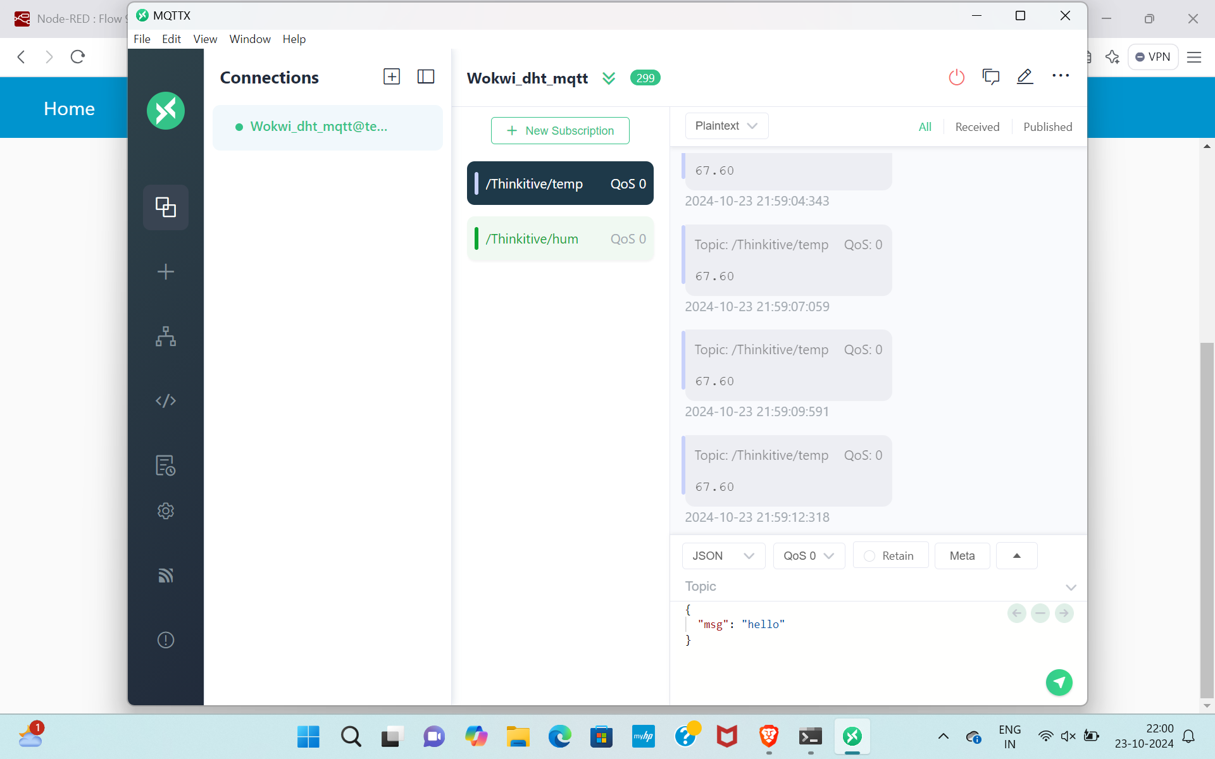
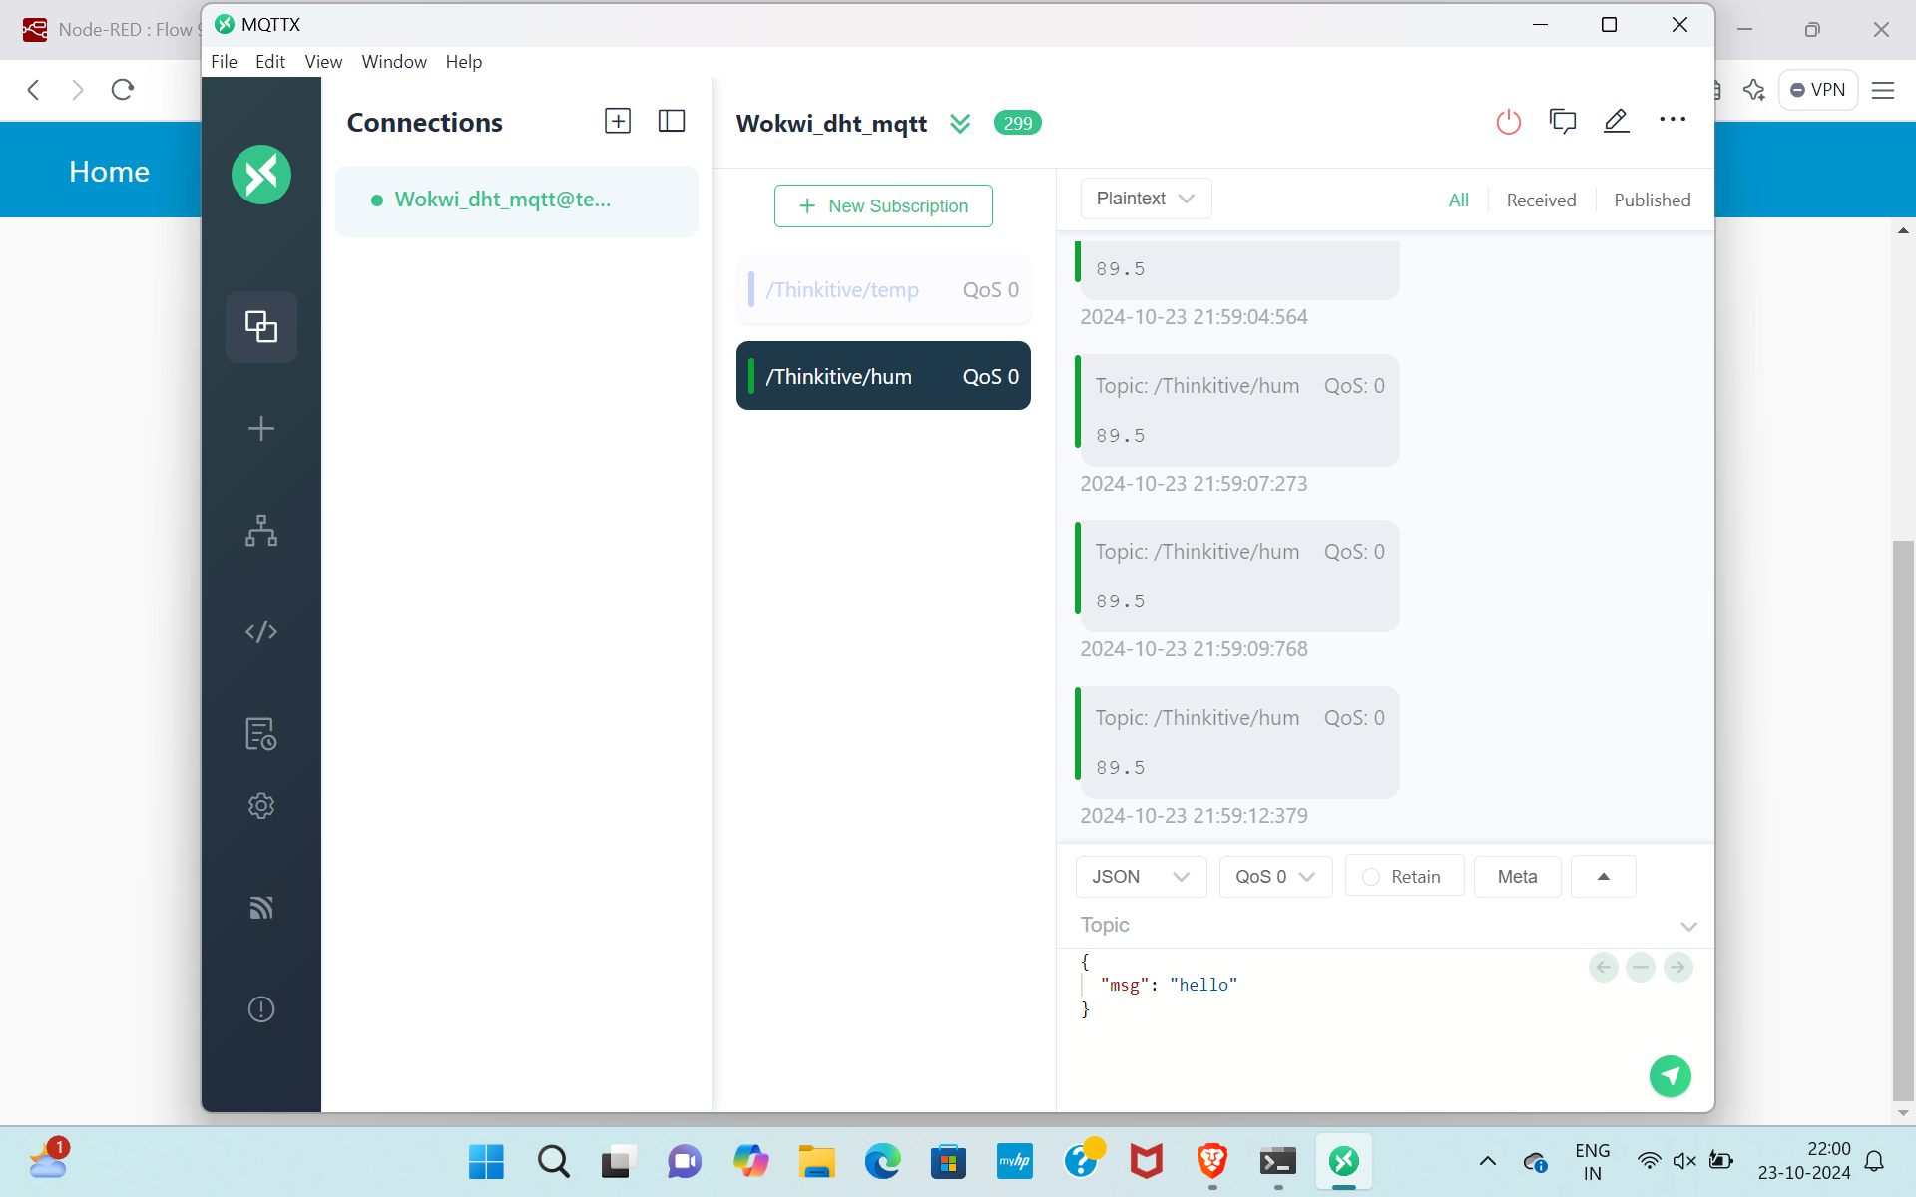
Implementation and Results – Iteration 3 (Optional)
Iteration : Results + Validation against the usecases and test cases

Slide 17
Contribution
Team Progress and Movement
Learning Basic Topics
Literature Survey – Base Papers
Implementation in NODE-RED, Wokwi, MQTTX
Displaying dashboard in NODE-RED
Individual Contribution
Key contributions: K. SOWMYA
Literature Survey
Wokwi code
Key contributions: R. MOKSHITHA
Literature Survey
NODE-RED
Key contributions: M. LOK VIGNESH
Literature Survey
Wokwi code, NODE-RED and MQTTX

Slide 18
Conclusion & Future Work
Summary and Conclusion
This IoT-based engine health monitoring system provides an innovative solution for real-time diagnostics of both traditional Diesel/Petrol and Electric Vehicle (EV) engines. By leveraging sensors, microcontrollers, MQTT protocols, and cloud computing, it ensures timely detection of engine faults, enabling predictive maintenance and reducing downtime. The integration with a Node-RED dashboard offers an intuitive, user-friendly interface for monitoring engine performance in real-time. This system promises to enhance engine longevity, optimize performance, and lower operational costs, making it a valuable tool for fleet managers and vehicle owners alike.
Future Work
Future Work:
Machine Learning Integration: Future versions could incorporate machine learning to predict engine failures with greater accuracy by analyzing historical and real-time data.
Expanded Sensor Range: Additional sensors for parameters like noise levels, emissions, and fuel consumption could provide more comprehensive diagnostics, enhancing system effectiveness.
Edge Computing: Implementing edge computing could allow local data processing on the microcontroller, minimizing latency and reducing reliance on cloud services, particularly in areas with poor connectivity.
Automotive Ecosystem Integration: Future iterations could integrate with vehicle telematics systems for seamless integration into automotive management platforms, providing deeper insights into fleet management and vehicle usage.
Self-Healing Capabilities: Introducing self-healing mechanisms where detected faults are automatically corrected without human intervention would significantly enhance system reliability and reduce downtime.

Slide 19

THANK YOU

